Slide 1

GROUP 6
Ila Srivastava
Gege Tao
Lakshmi Sravya Katta
Junyan Zhao
Zhen Wu
Kobe Bryant Shots Prediction Analysis

Slide 2
CONTENT
Introduction
Pre-analysis
Modeling
Conclusion

Slide 3
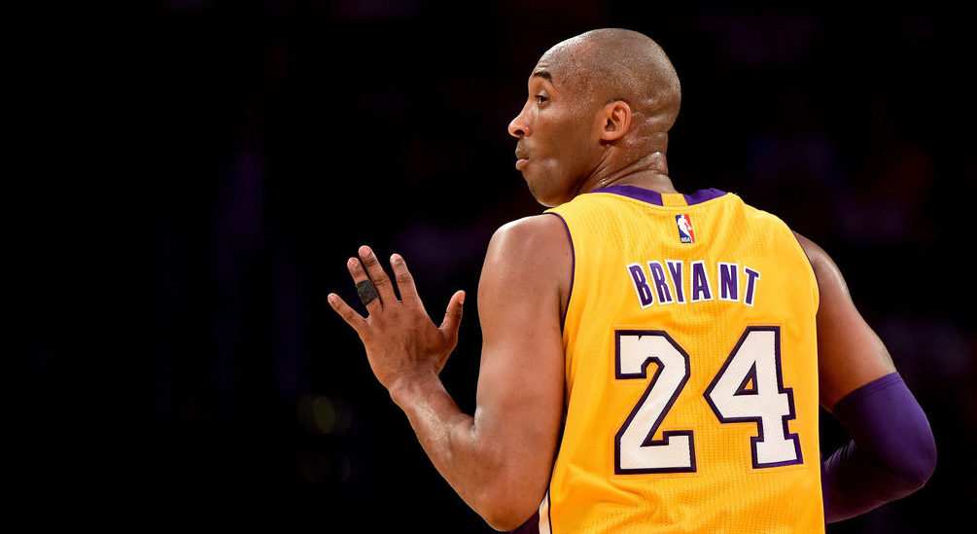
1
What is the problem you’re trying to solve?
The problem we are trying to solve involves predicting whether former NBA star Kobe Bryant makes or misses a shot based on several factors of the shot, such as distance from basket, type of shot, and opponent. This will help us analyzing the relationships between these variables and finally, coming up with an accurate model predicting shot accuracy.

Slide 4
1
How do you intend to solve it?
1
2
EDA
Indicators of shot accuracy
We try to use exploratory data analysis (EDA) i.e., an approach to analyzing data sets to summarize their main characteristics, often with visual methods.
We will try to analyze various indicators of shot accuracy such as age, month, shot count, type of shot, shot distance to understand the correlation between these factors, while accounting for control variables.
4
3
Regression Models
Visual Analysis
We will build regression models to identify the best one for predicting whether a shot is successful or not.
We will do extensive visual analysis to understand the importance of basketball court and competition condition.

Slide 5
CONTENT
Introduction
Pre-analysis
Modeling
Conclusion

Slide 6
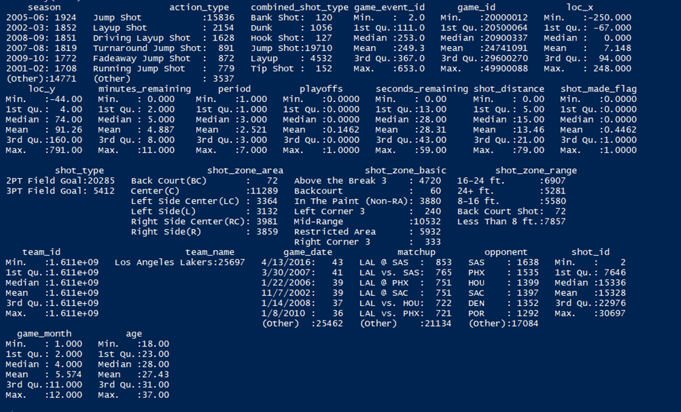

2
Summary statistics
Firstly, we took a primary look at the dataset. As the following figure shows, there are 25697 records and 23 original variables and two new variables we developed ‘game_month’ and ‘age’. The datatypes of each variable are mainly numeric and factor.
Also, the figure indicates that there is no missing value and We can see the mean, median, quartiles, etc. for all the columns.
We calculated Kobe’s general shot accuracy shown as the following figure, which is 0.446161.

Slide 7
2
Feature Development
•Extracted month from column 'game_month' generating a new column called 'game_month’,
• Created a new column called ‘body age’ by adding Kobe's age data of each season. The reason why we added this new column was because we considered that if we wanted to analyze in which month, Kobe performed better, we should make it clearer, for example, when Kobe was 21, he played better in October. Kobe’s body age is an important feature.

Slide 8
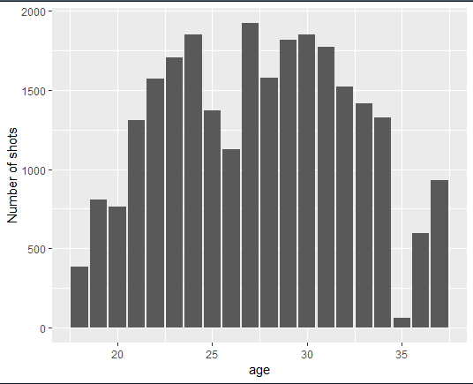
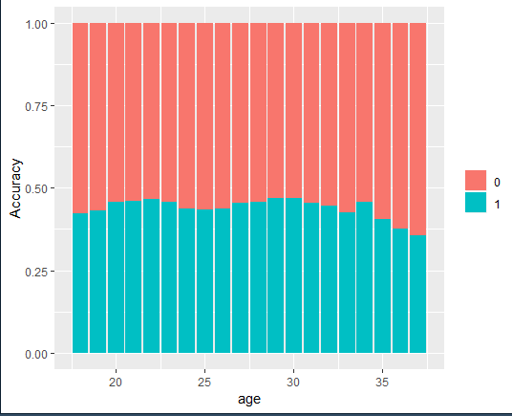
2
Exploratory Data Analysis : Relationship between Kobe’s age and shot accuracy
The problem we are trying to solve involves predicting whether former NBA star Kobe Bryant makes or misses a shot based on several factors of the shot, such as distance from basket, type of shot, and opponent. This will help us analyzing the relationships between these variables and finally, coming up with an accurate model predicting shot accuracy.
After 35, Kobe made less shots and lower shot accuracy.

Slide 9
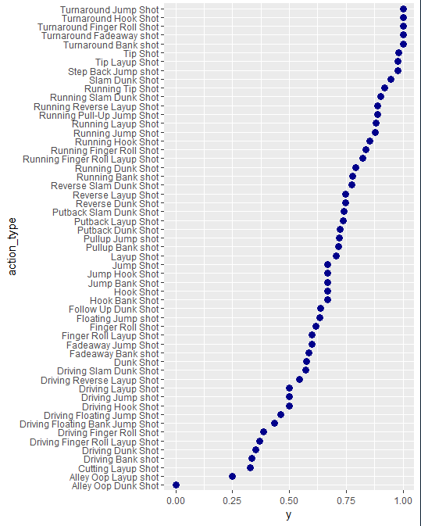
2
Exploratory Data Analysis : Relationship between Kobe's shot accuracy and action type
We found some action type of Kobe have higher accuracy, for example, the top five on the diagram. Kobe should try to lower the chance to play the lower accuracy actions.

Slide 10
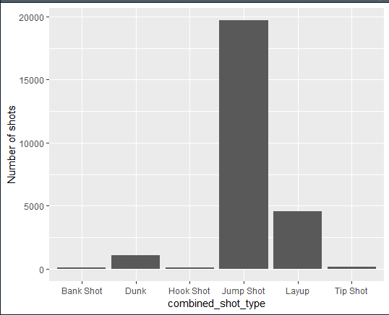
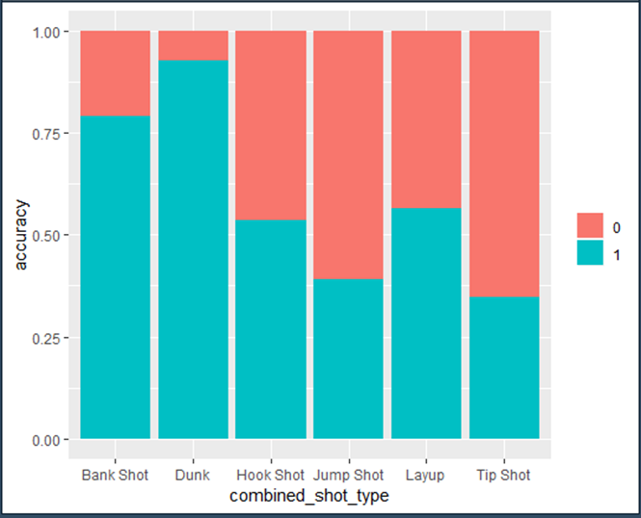
2
Exploratory Data Analysis :
Analysis of Kobe's combined shot type and its relationship with shot accuracy
Jump shot, Drunk, Layup are the top three shot type Kobe open made, for the accuracy, Drunk, bank shot, and layup have the highest accuracy. Maybe Kobe should have more these shot types more. For example, transfer from jumpshot to drunk shot.

Slide 11
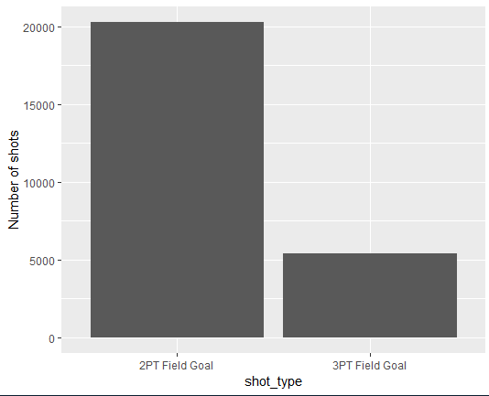
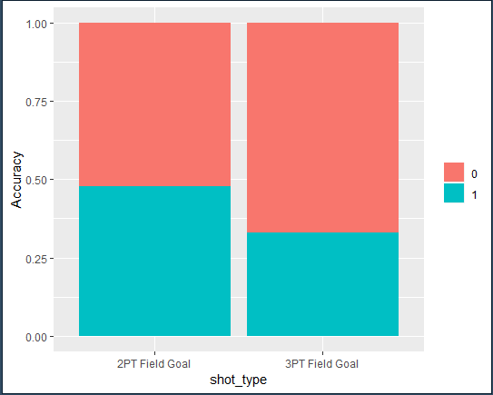
2
Exploratory Data Analysis :
Analysis of Kobe's 2pt/3pt shots and its relationship with shot accuracy
The 2PT shot has higher accuracy than 3PT shot.

Slide 12
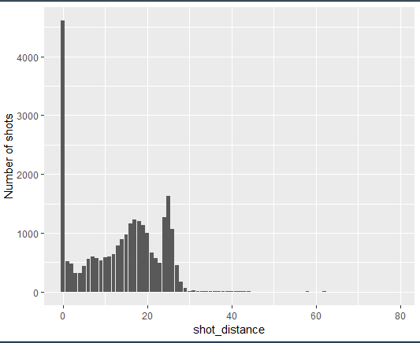
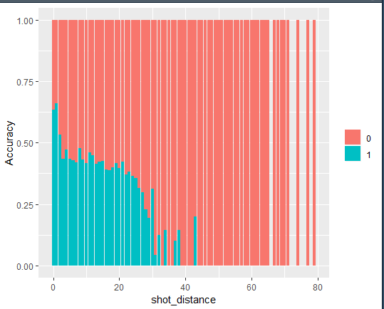
2
Exploratory Data Analysis :
Analysis of Kobe's shot distance and its relationship with shot accuracy
The diagram demonstrates with 0 shot distance; the accuracy is the highest. When 0 < distance < 30, the accuracy performs stable.

Slide 13
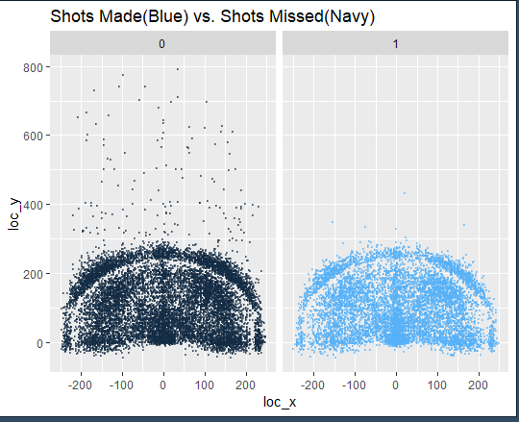
2
Exploratory Data Analysis :
Analysis of whether shot has been made or not by position

Slide 14
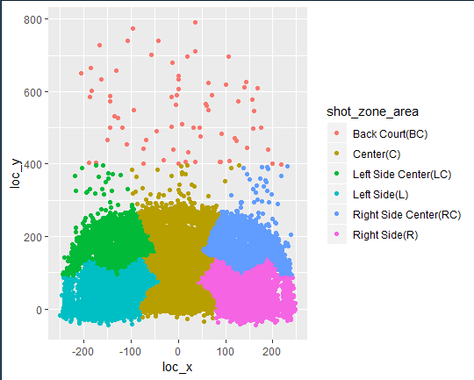
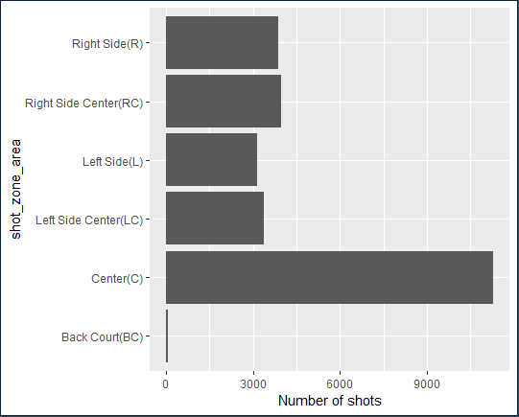
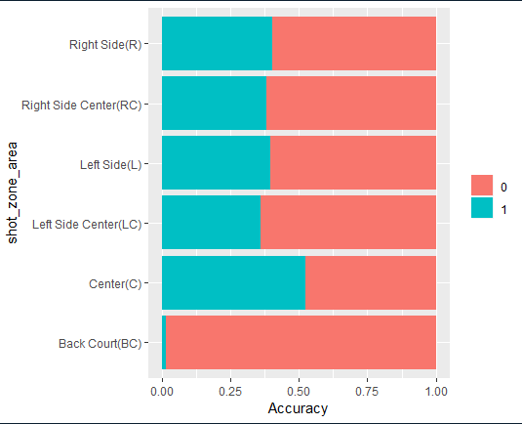
2
Exploratory Data Analysis : Analysis of the shot area in which Kobe performed better
· Kobe has highest number of shots in ‘Center’ shot area
and its accuracy is the best whereas ‘bank court’ area is the exact opposite.

Slide 15
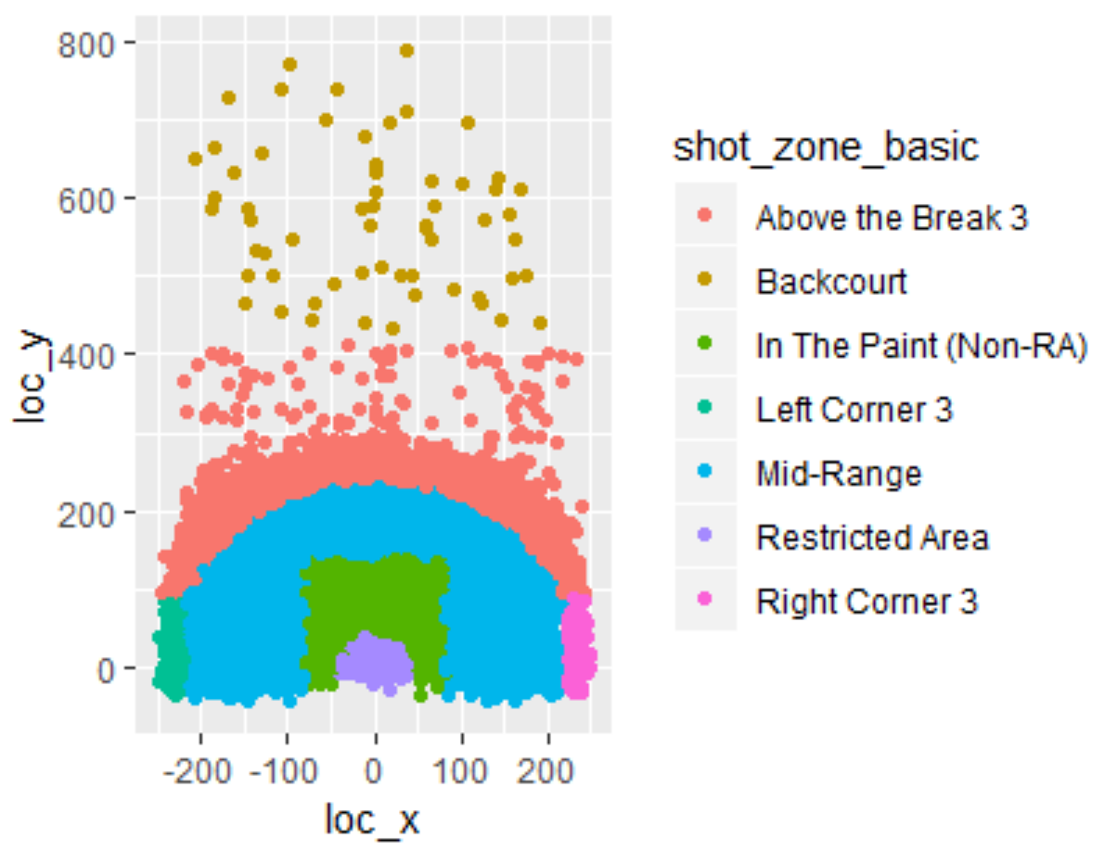
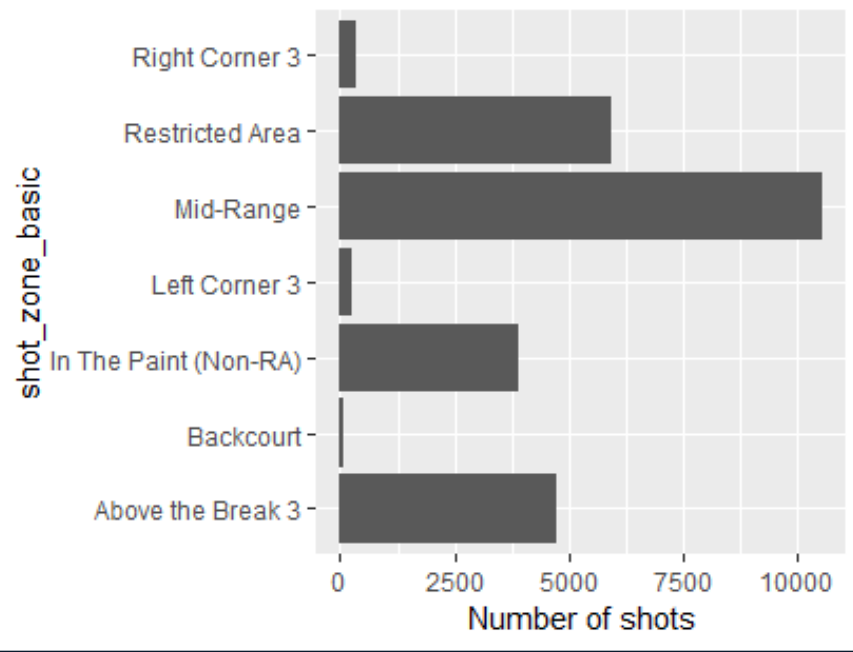
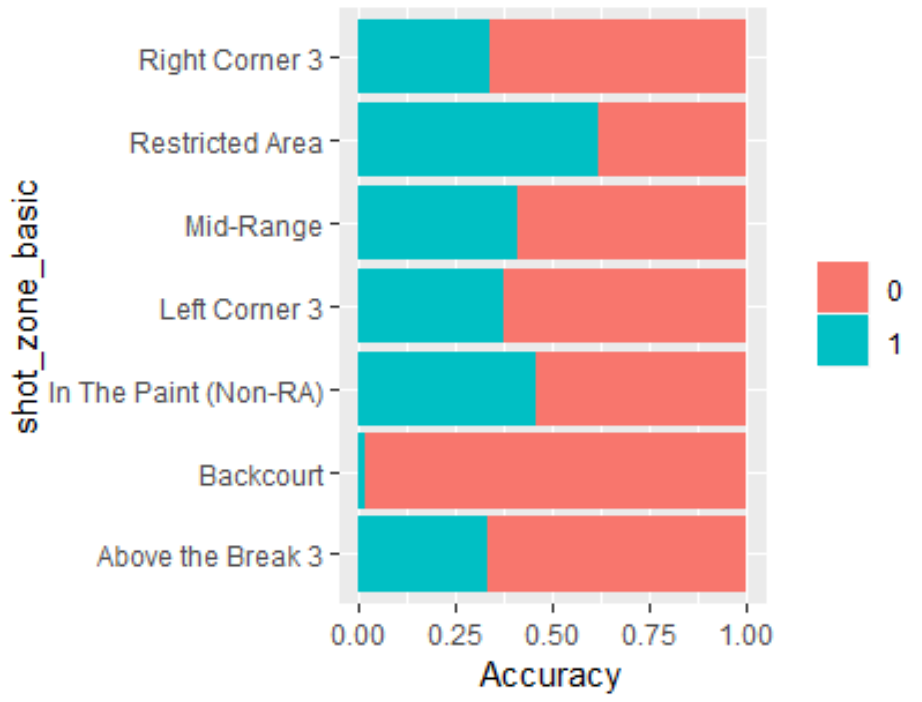
2
Exploratory Data Analysis : Analysis of the Shot distance in which Kobe performed better
·The number of shot and accuracy vary substantially by shot_zone_basic
Kobe preferred shot in mid-range area and restricted area and he did perform the best in these two areas. Also, although Kobe seldom made shots in left corner, right corner and backcourt, he did well in the left corner and right corner.
Kobe performed better in left corner than he did in right corner, which indicates that he is an all-round basketball player

Slide 16
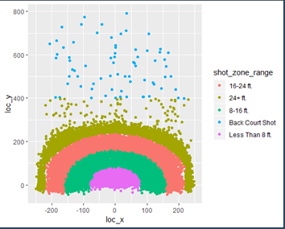
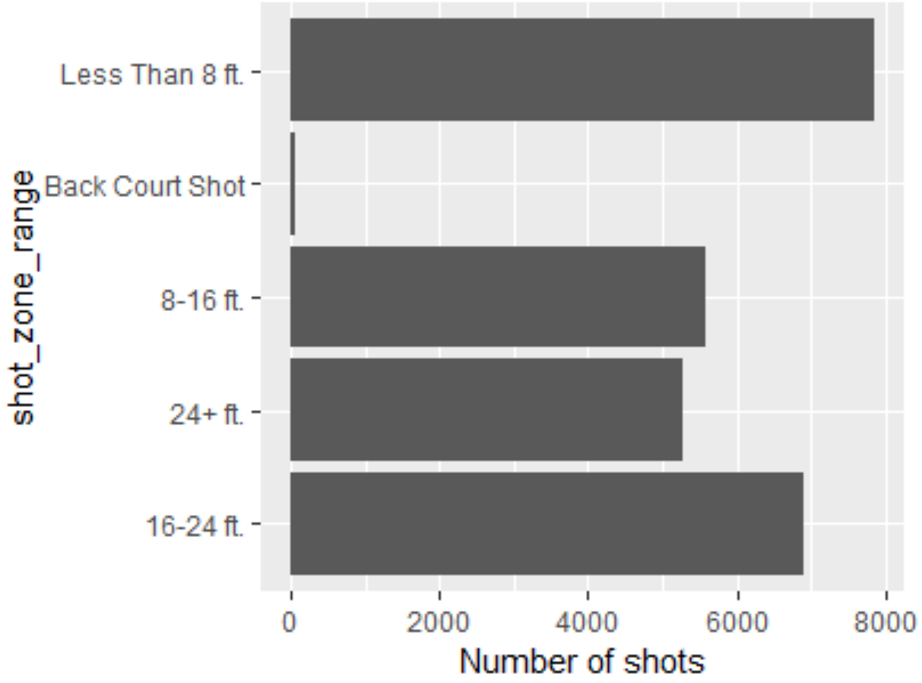
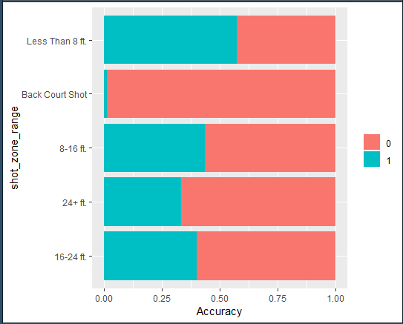
2
Exploratory Data Analysis : Analysis of shot zone range in which Kobe performed better
The outcome is corresponding to the above analysis of Kobe’s shot distance and its relationship with shot accuracy.

Slide 17
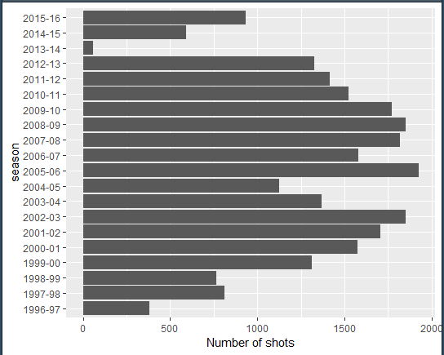
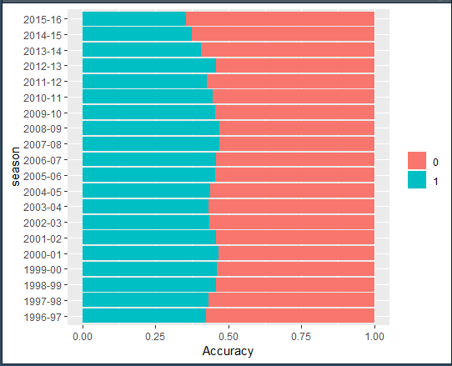
2
Exploratory Data Analysis : Analysis of the season in which Kobe performed better
The period from season 1997-98 to season 2012-13 was Kobe’s career heyday.
He always had a steady performance in accuracy
The outcome is corresponding to the analysis of Kobe’s age influence on his shot accuracy.

Slide 18
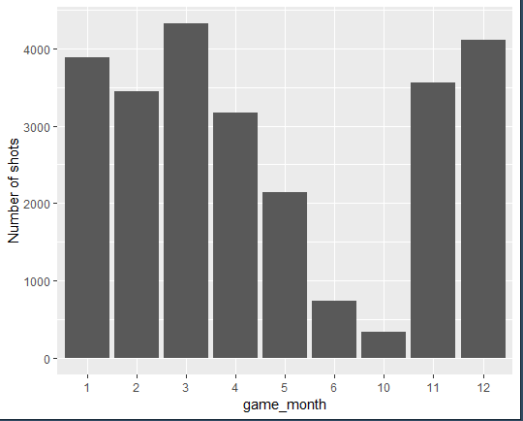
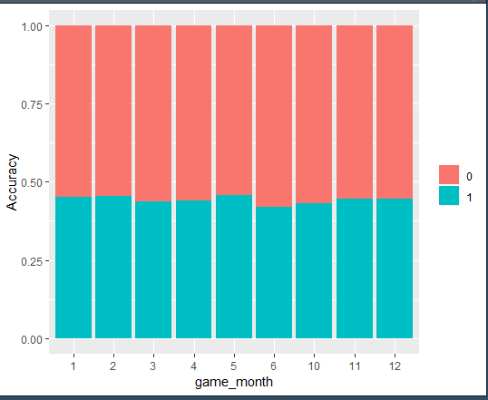
2
Exploratory Data Analysis : Analysis of Month in which Kobe performed better
Although Kobe made more shots in autumn and winter, he always had a steady performance no matter in which month the competition was held.

Slide 19
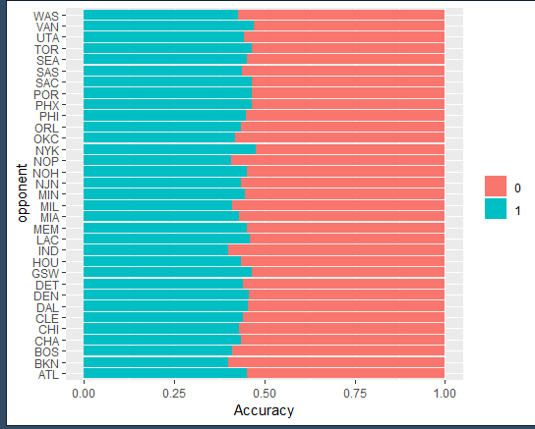
2
Exploratory Data Analysis :
Analysis of Kobe’s performance when played certain opponents
Kobe’s has good accuracy with his opponents. But the best accuracy is when he plays with NYK

Slide 20
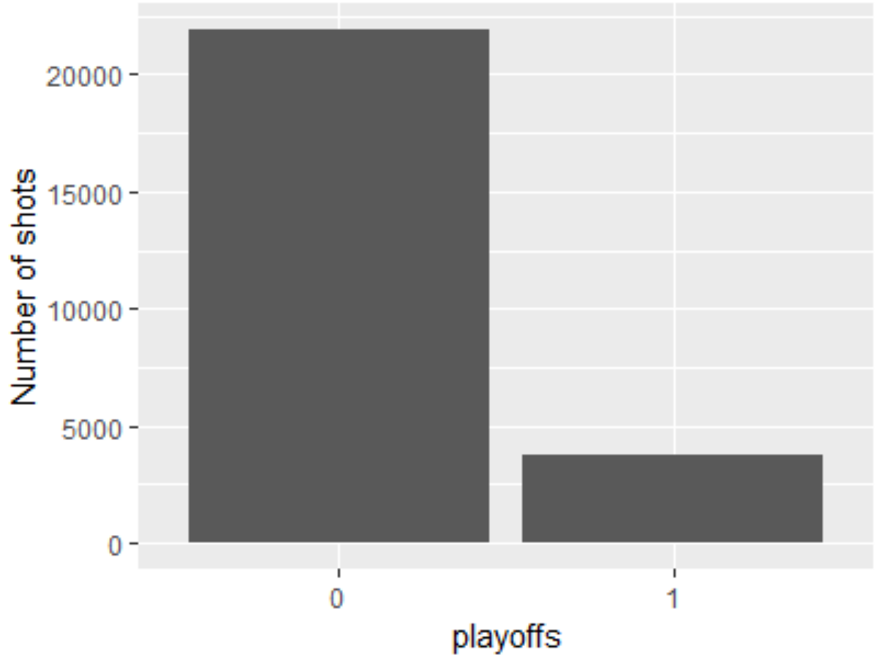
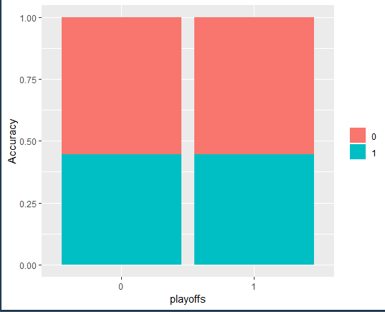
2
Exploratory Data Analysis :
Analysis of Kobe's performance in regular season and playoff
There is no difference in Kobe's performance when compared between regular season and playoffs.

Slide 21
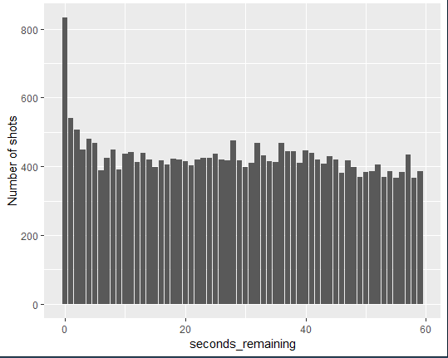
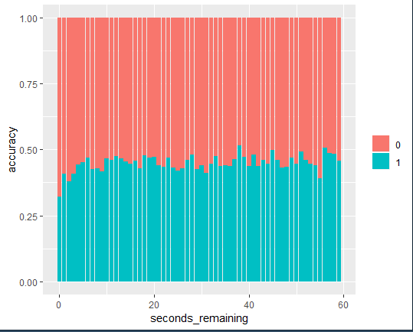
2
Exploratory Data Analysis :
The relationship between seconds remaining and Kobe’s shot accuracy
Kobe’s has highest number of shots when there are 0 seconds remaining indicating he has selected for free throws a lot but his accuracy is also lowest at this time.

Slide 22
2
Hypothesis
We have come up with the following hypotheses
• Kobe’s age has no significant influence on predicting shot_made_flag.
• Kobe’s action type and combined action type could have a significant influence on predicting shot_made_flag.
• Shot distance has a significant influence on predicting shot_made_flag.
• The shot zone area, shot zone basic and shot range in a basketball court could have a significant influence on predicting shot_made_flag.
• Game season, month, opponent, playoffs or not and periods have no significant influence on predicting shot_made_flag.
• Although Kobe did not perform very well in the final seconds, it does not seem that Kobe’s performance varies enough for time to be a significant variable.

Slide 23
CONTENT
Introduction
Pre-analysis
Modeling
Conclusion

Slide 24
3
What type of model are you using and why?
1
Ridge logistic regression
2
Lasso logistic regression

Slide 25
3
What variables did you choose for your model?
Ridge
regression
We need to split the data into training and testing dataset by 70:30.
Lasso regression

Slide 26
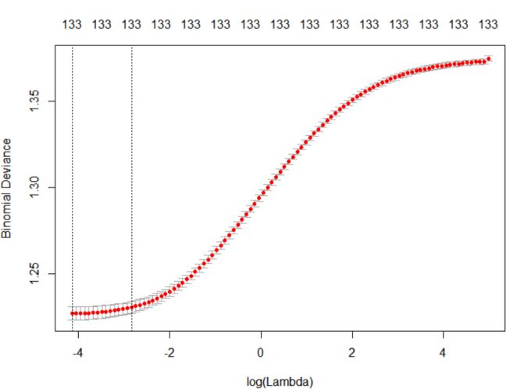
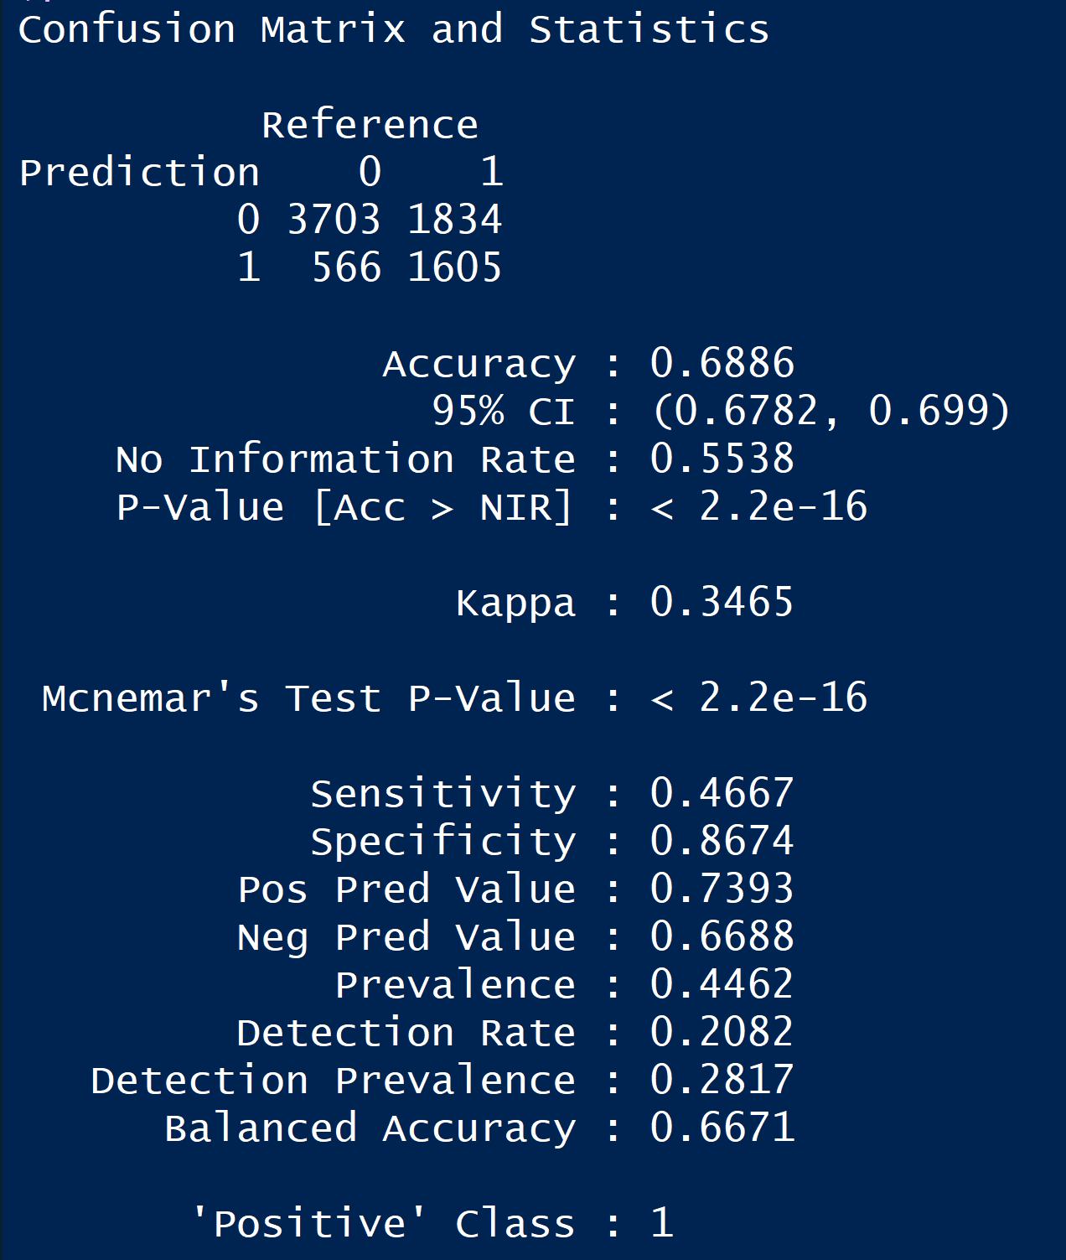
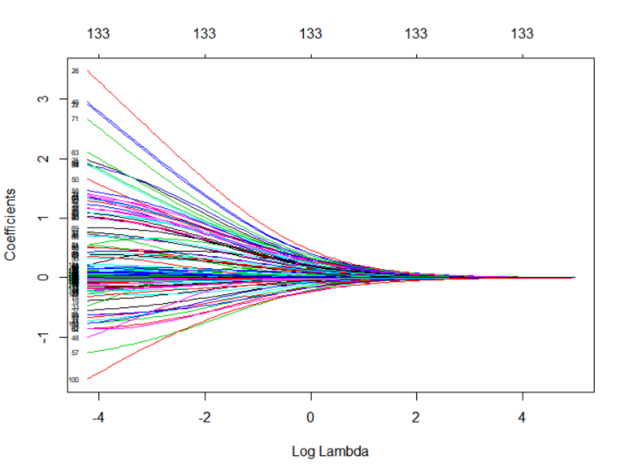
3
What is the output of your model mean?
Ridge regression

Slide 27
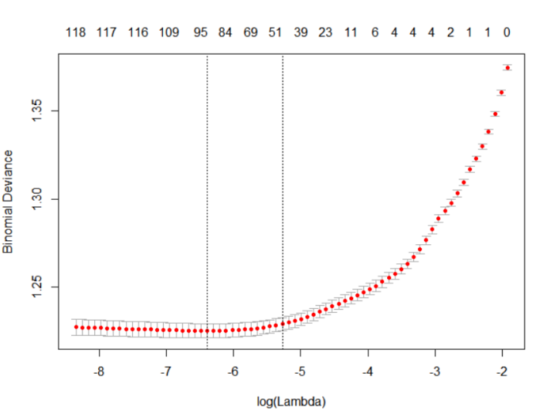
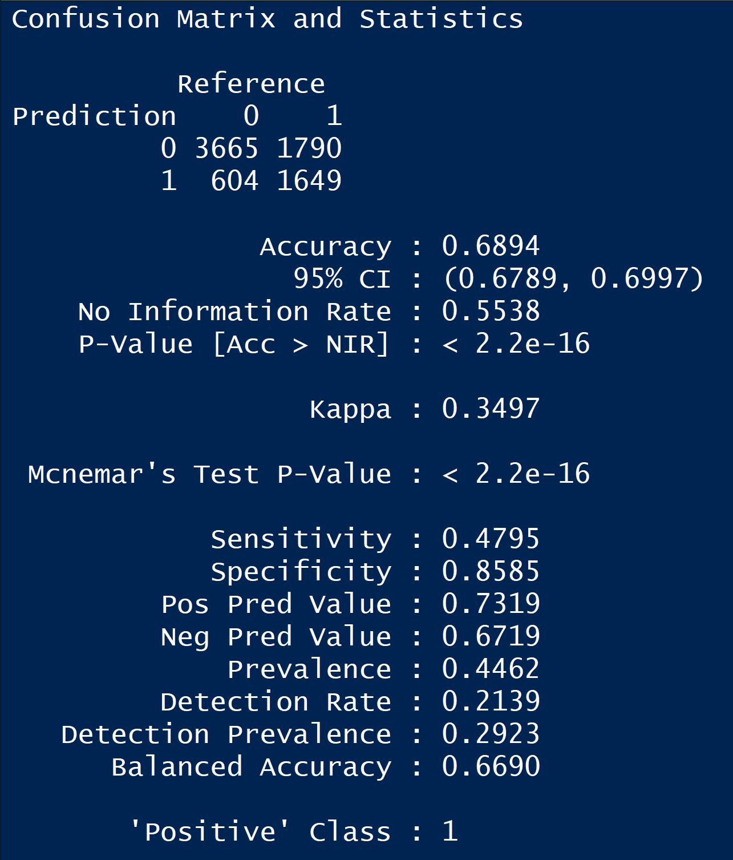
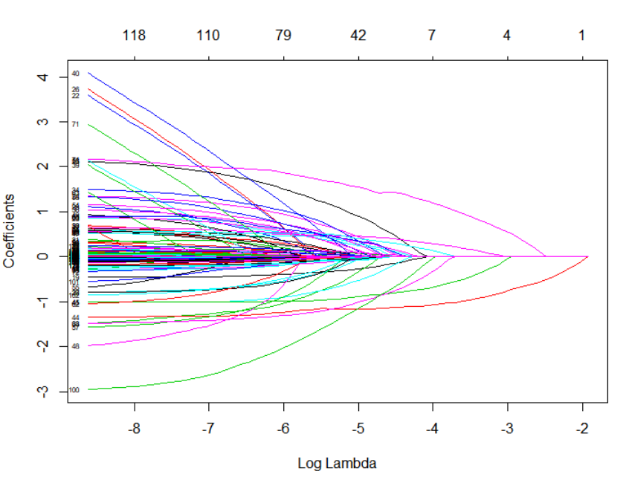
3
What is the output of your model mean?
Lasso regression
The Lasso model performs the best, which indicates that we do not need all the features.

Slide 28
CONTENT
Introduction
Pre-analysis
Modeling
Conclusion

Slide 29
Conclusion
Based on our initial hypotheses, analysis of coefficients and accuracy, we learned that lasso logistic regression model is the most parsimonious and preferred out of the models developed.
Kobe’s age, his shot distance and shot type, game’s month and playoffs or not do not have a significant influence on Kobe’s shot accuracy.
Kobe’s action type, combined shot type and shot zone have a significant influence on Kobe’s shot accuracy.
Lasso model shows that shot distance has no clearly significant influence on Kobe’s shot accuracy.
Lasso model shows that season 1997-98, 2014-15, 2015-16 have a significant influence on Kobe’s shot accuracy probably because in these seasons, probably due to his young age.
The lasso model shows that minutes_remaining, seconds_remaining and periods are significantly important variables.

Slide 30

What would you like to improve in the future?
For the project, the dataset does not quite fit our assumption.
We can try more pre-analysis methods to digest more aspects of the project.
We can use more models to recheck our results.
We can do more visualization to understand the correlation between variables.
We can extract some data to do cross-validation in order to recheck
If possible, we can even try to add some creative new variables to improve the accuracy of the predicted model.
For future study, we need to keep the focus on the statistical learning and put what we learned in class into real-world practice.

Slide 31
Thank you

